Slide 1
CN-002 Real Data Application
July 2016

Slide 2
主要内容
Real Data Application (RDA)概述
创建脚本（Provisioning）
运行脚本
日志实时查看和分析
支持和帮助
附录

Slide 3


Real Data Application (RDA)概述
TM500 & RDA集成测试环境
RDA产品架构及简介
RDA环境连线
RDA客户端

Slide 4
RDA业务服务器
常提及的几个名称
diversifEye是业务服务器产品的统称，包含D500/D1000/R630。diversifEye集成到TM500测试环境后，在软件层面，又被称为Real Data Application (RDA).
diversifEye是业务服务器客户端，最新的客户端已更名为TeraVM.
Shenick是业务服务器的提供商，以前是Aeroflex的合作伙伴。
Shenick后来被Aeroflex收购；Cobham后续又收购了Aeroflex.
功能
多小区测试环境下，为成千上万终端并行提供各种数据业务。
模拟的应用程序包括FTP/HTTP/TeraFlow/RTSP/VoLTE/PING等等。
同时模拟应用程序客户端（Edge）和服务器（Core）。
支持端到端的测试，实时QoS以及应用程序级别的关键性能指标评估。
D500/D1000最多并行支持6个TM500测试环境。

Slide 5
TM500 & RDA集成测试环境
#待补充真实测试环境图示

Slide 6
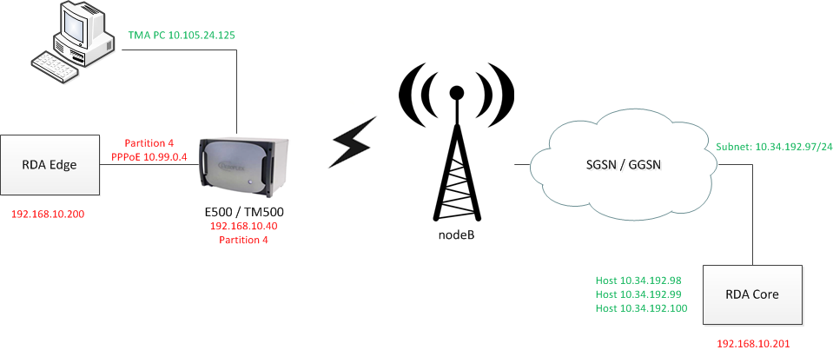
TM500 & RDA集成测试环境
Hosts and traffic applications are configured on a single GUI
Edge side
Core side

Slide 7












RDA产品架构
Application Options
Thresholding
Passive Analysis
SMS over IMS
Voice services
Video services
TeraFlow
TWAMP
Traffic Generation Options
3.6Gbps DL Traffic – R630
2.7Gbps DL Traffic – R630
1.8Gbps DL Traffic – R630 or D1000 Edge+Core
HTTP
FTP
900Mbps DL Traffic – D500 Edge+Core
eMail
Ping
450Mbps DL Traffic – D500 Edge
Hardware Platforms
D500
D1000
R630

Slide 8
RDA平台简介
D500 – D1000 – R630
D500
I/O – 1x 1Gbps
Fixed VLANs per User
SGi Servers I/O use VLAN tags
Number of UEs
6 000
Number of Applications
24 000 provisioned application clients
12 000 concurrent application clients
Number of PDN connections
12 000
Number of fine statistics
500 entities
D1000
I/O – 2x 1Gbps
Fixed VLANs per User
SGi Servers I/O use VLAN tags
Number of UEs
12 000
Number of Applications
48 000 provisioned application clients
24 000 concurrent application clients
Number of PDN connections
24 000
Number of fine statistics
500 entities
R630
I/O – 2x 10Gbps
Configurable VLANs per User
SGi Servers can be used without VLAN tags
Number of UEs
36 000
Number of Applications
288 000 provisioned and concurrent application clients
Number of PDN connections
72 000
Number of fine statistics
24 000 entities
Near-real time Streaming of statistics

Slide 9
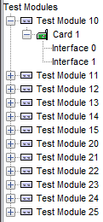
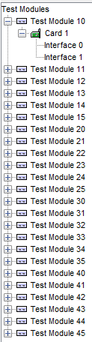
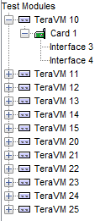
RDA平台简介
D500 – D1000 – R630

Slide 10


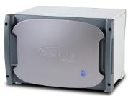



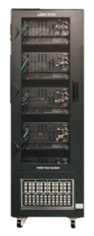






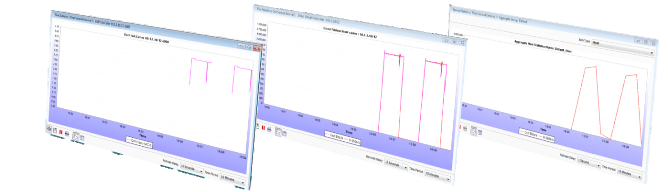
RDA业务关键性能分析
per Application
per flow performance measurements
per UE
Aggregate performance

Slide 11
RDA环境连线
Standalone D500 Edge/Core
#待补充环境连线图

Slide 12
RDA环境连线
D500 Edge and Core Pair
#待补充环境连线图

Slide 13
RDA环境连线
Standalone Edge/Core D1000
#待补充环境连线图

Slide 14
RDA客户端
下载及安装
早期的RDA客户端diversifEye，最新的客户端TeraVM
默认的管理IP地址：192.168.10.200.
请通过网页浏览器登录管理页面，下载安装RDA客户端。
默认安装即可
访问某些RDA管理页面需要用户名和密码。
用户名：diverAdmin
密码：diversifEye

Slide 15
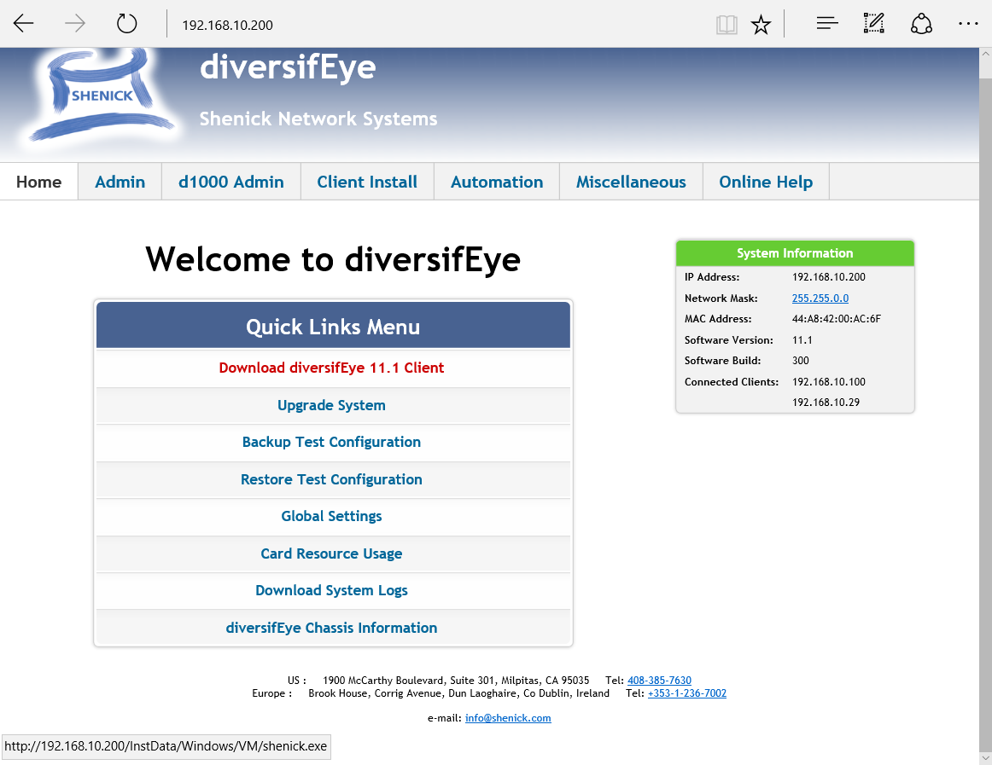
RDA客户端
下载及安装

Slide 16
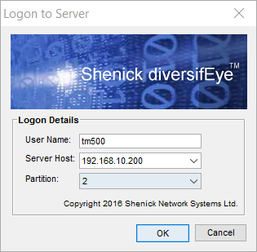
RDA客户端
登录
通过客户端diversifEye/TeraVM登录RDA
User Name：tm500（不建议用其它用户名，因为可能导致TM500无法调用RDA脚本）。
Server Host: 192.168.10.200 （默认）。
Partition: 根据RDA测试环境连线，选择对应的Partition.

Slide 17
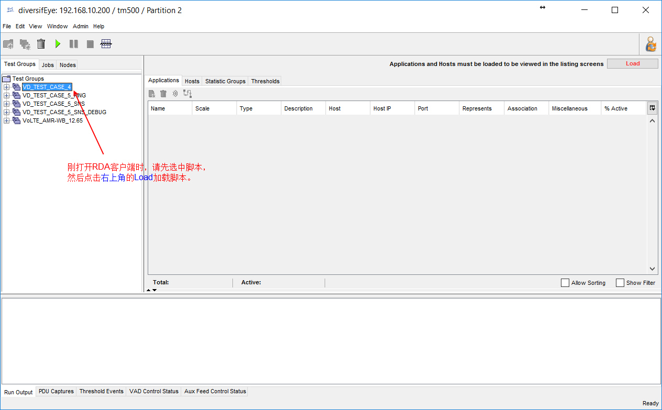
RDA客户端
基于Java的GUI

Slide 18
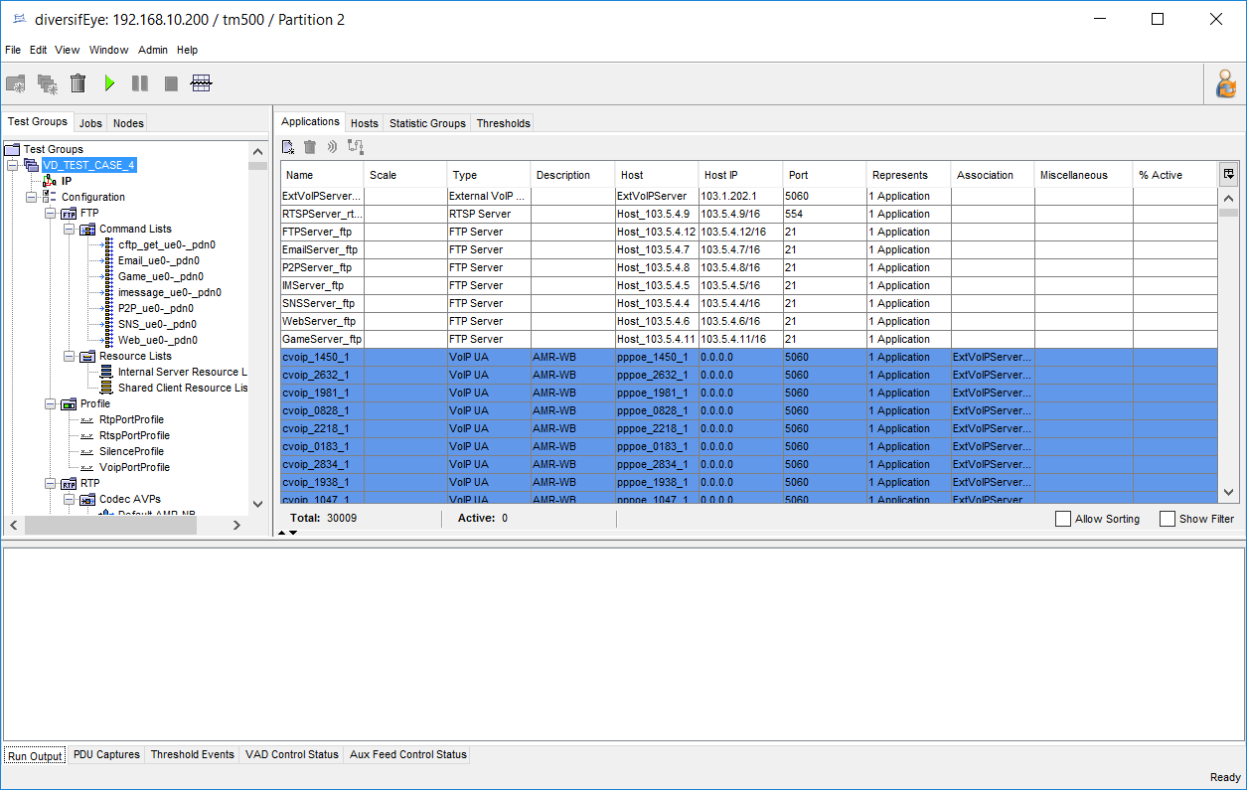
RDA客户端
Test Groups/Applications

Slide 19
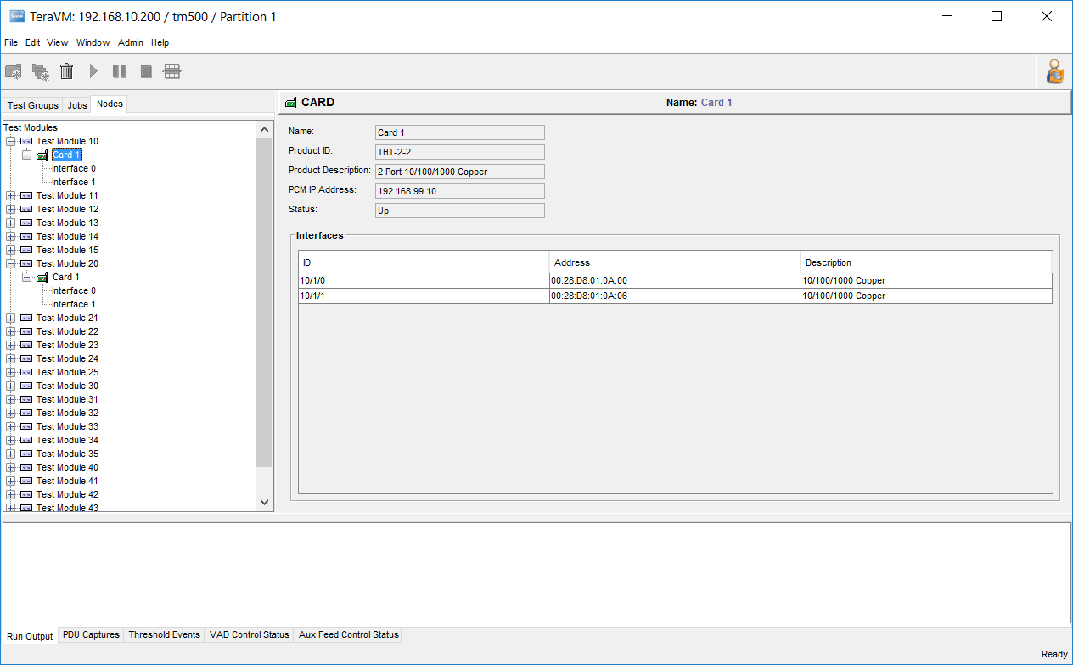
RDA客户端
Nodes

Slide 20
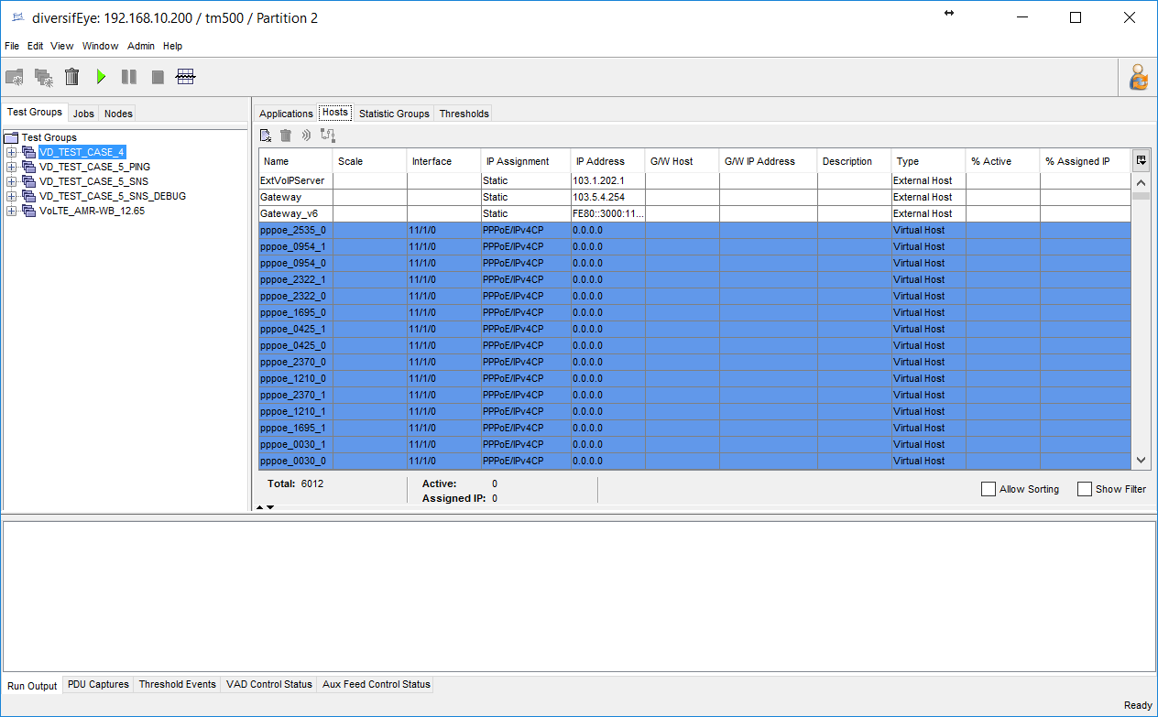
RDA客户端
Hosts

Slide 21
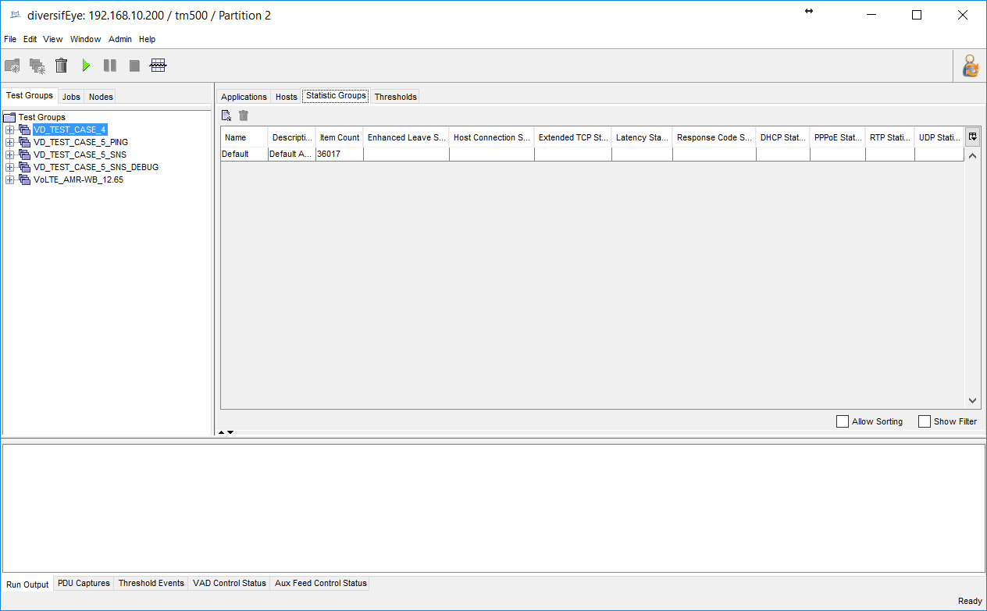
RDA客户端
Statistic Groups

Slide 22
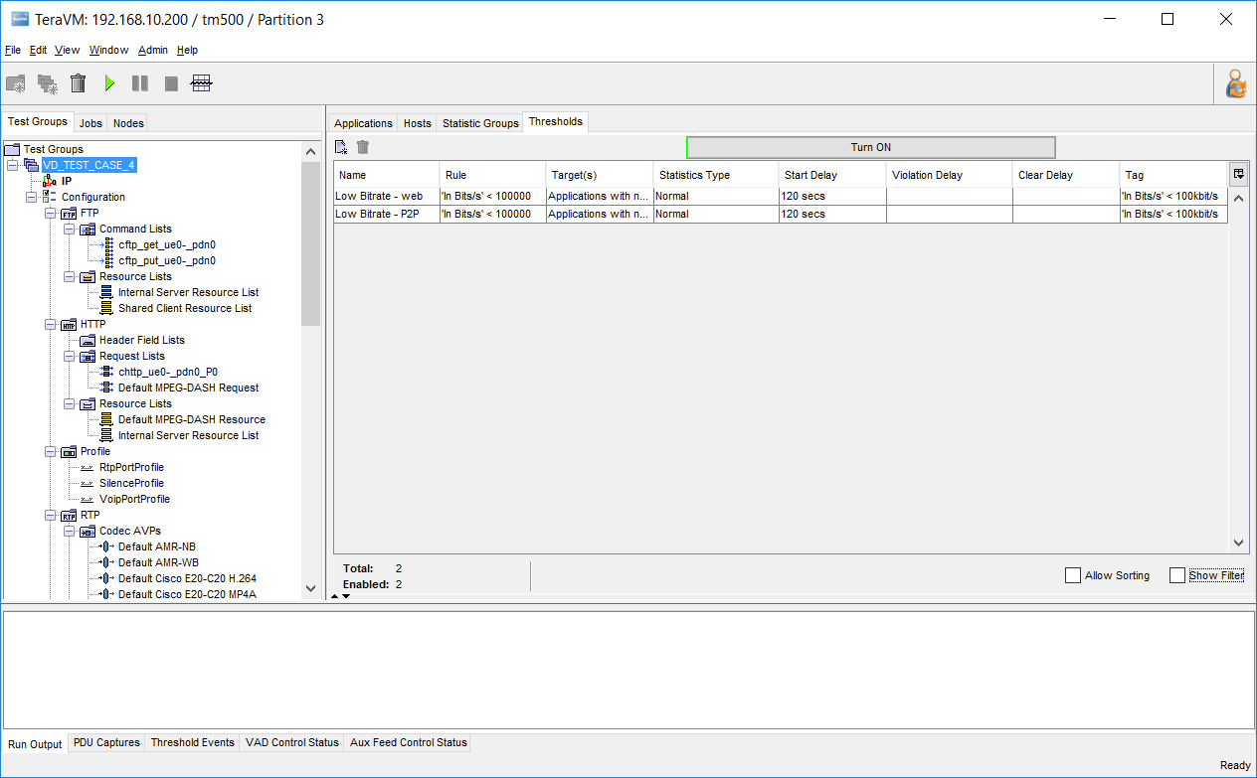
RDA客户端
Thresholds

Slide 23
创建脚本（Provisioning）
Python安装和设置
RDA Provisioning
导入和导出脚本

Slide 24
Python安装和设置
Provisioning ：通过配置文件（tm500.xml），用Python批量生成RDA脚本，这个过程称为Provisioning.
电脑运行环境配置
依次下载安装Python相关软件
python-2.7.5.msi
pywin32-214.win32-py2.7.exe
wxPython2.8-win32-unicode-2.8.12.1-py27.exe
xlrd-0.7.9.win32.exe
添加Python安装路径（ C:\Python27\）至系统的环境变量。
右键点击“我的电脑”，选择“属性”；
选择“高级” -> “环境变量”
注意：Win7和Win10对应的环境变量配置界面略有区别。

Slide 25
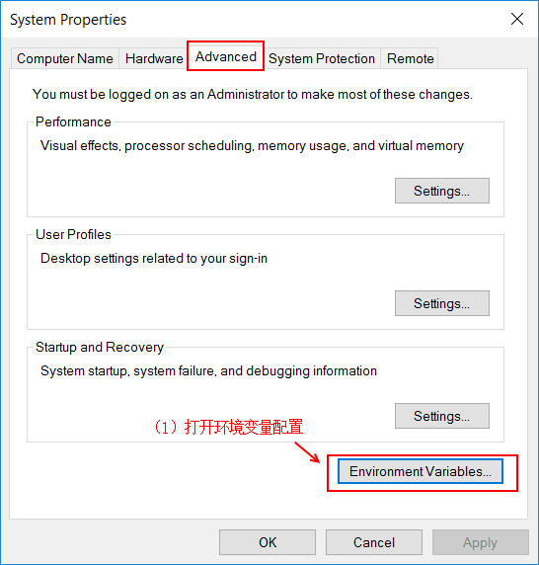
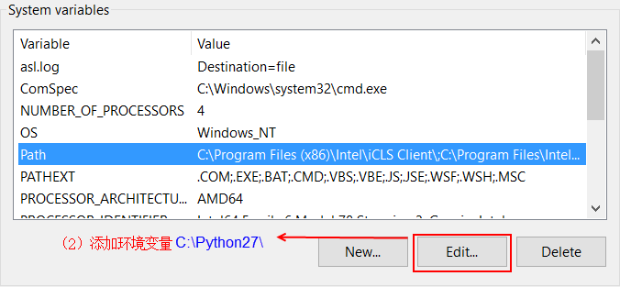
Python安装和设置

Slide 26
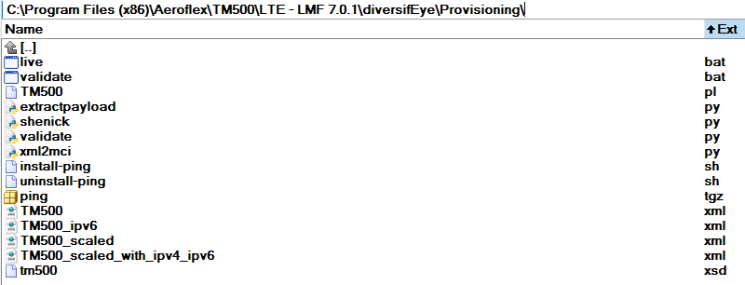
RDA Provisioning
每个CUE TM500软件的安装目录下都有Provisioning模板，例如：
Win7和Win10的C:\Program Files\和C:\Program Files (x86)\目录下的操作需要管理员权限，所以请把Provisioning拷贝到其它路径再进行修改及其它操作。
根据测试需求，有两个文件需要更新
live.bat
TM500.xml

Slide 27
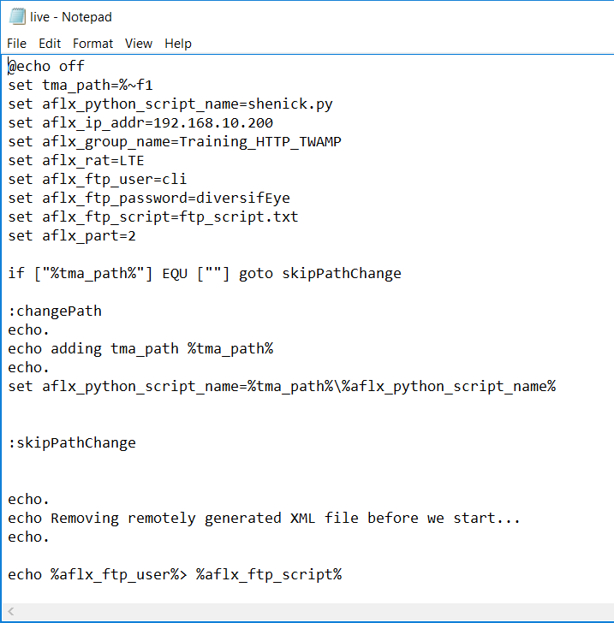
RDA Provisioning
live.bat
live.bat: 批处理文件，配置基本环境变量，调用shenick.py生成RDA脚本。需要更新以下信息：
aflx_ip_addr：RDA IP地址
aflx_group_name：RDA脚本名字
aflx_part：Partition

Slide 28
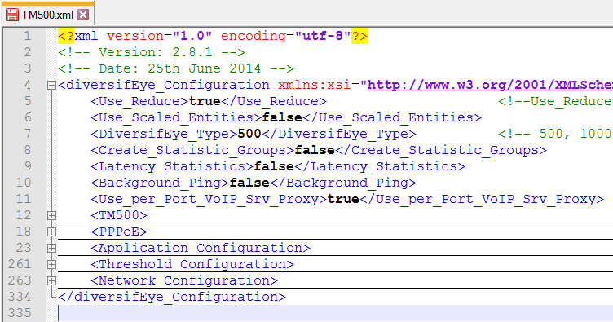
RDA Provisioning
TM500.xml
TM500.xml: RDA配置文件，live.bat将根据此配置文件生成相应的RDA脚本并自动上传至RDA。
配置文件主要包含以下模块

Slide 29
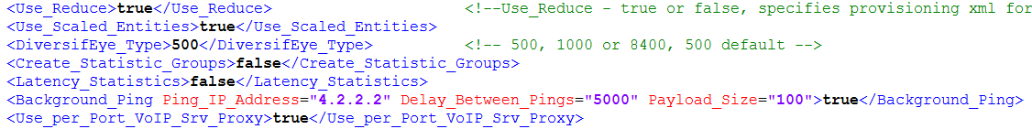
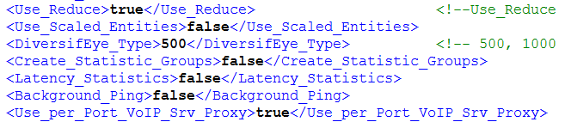
RDA Provisioning
基本配置信息
模板默认配置
建议更新如下配置
Use_Scaled_Entities
Background_Ping

Slide 30
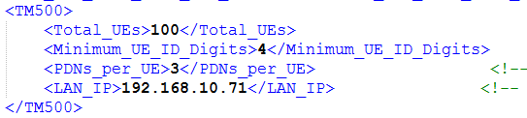
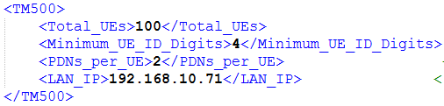
RDA Provisioning
TM500 Block
模板默认配置
请根据测试需求及环境更新如下配置
Total_UEs
PDNs_per_UE
LAN_IP：TM500业务口IP地址，用于PPPoE拨号
如果是VoLTE相关测试的话，一般建立两个APN，配置更新如下

Slide 31
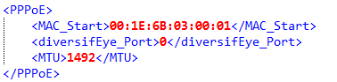
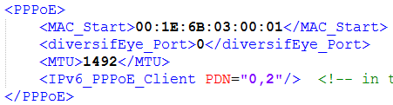
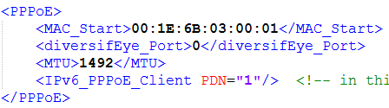
RDA Provisioning
PPPoE Block
模板默认配置（IPv4），建议采用默认配置。
模板默认配置（IPv6）
如果是IPv6 VoLTE UE的话，第二个APN用于承载VoLTE，对应的APN为1，配置更新如下所示
IPv6_PPPoE_Client

Slide 32
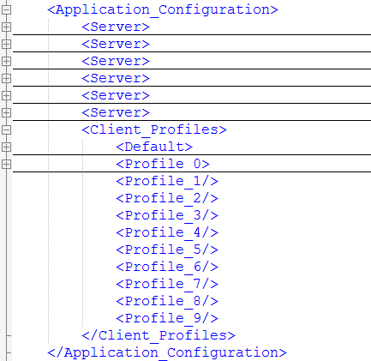
RDA Provisioning
Application Block
Application模块配置包含两部分
服务器相关配置
客户端相关配置
默认配置（<Default>）：默认客户端
Profile_N配置（<Profile_N>）：除了默认客户端，同一个服务器还可以配置多个客户端。

Slide 33
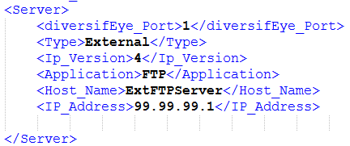
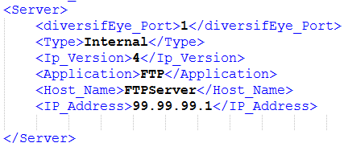
RDA Provisioning
FTP Server Configuration
模板默认配置
主要待更新配置
Type/Host_Name/IP_Address

Slide 34
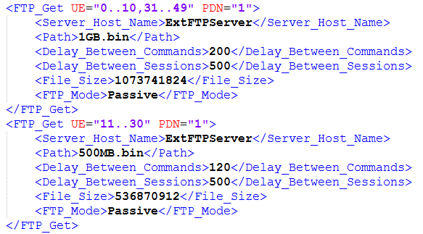
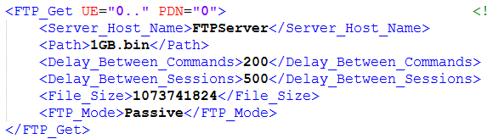
RDA Provisioning
FTP Client Configuration (Get)
模板默认配置
主要待更新配置
UE/PDN/Server_Host_Name

Slide 35
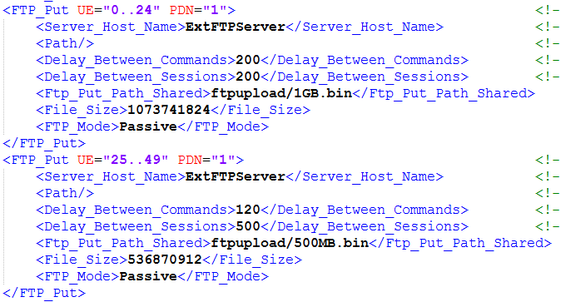
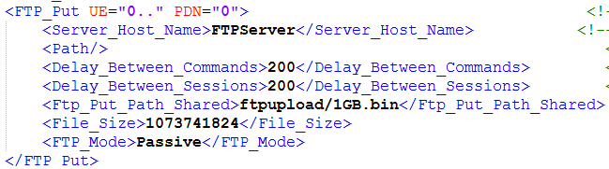
RDA Provisioning
FTP Client Configuration (Put)
默认模板配置
主要待更新配置
UE/PDN/ Server_Host_Name

Slide 36
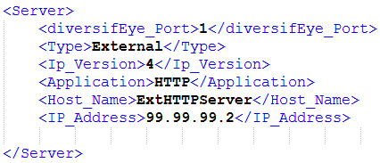
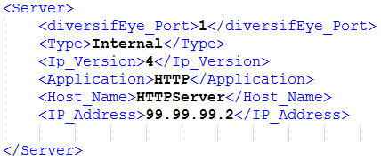
RDA Provisioning
HTTP Server Configuration
默认模板配置
主要待更新配置
Type/Host_Name/IP_Address

Slide 37
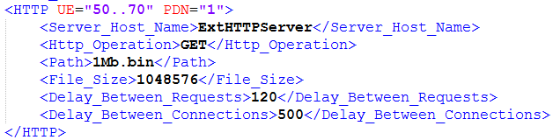
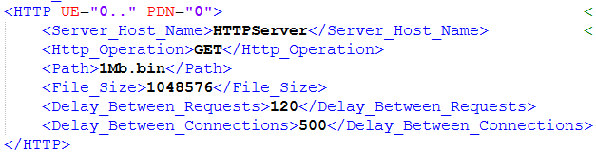
RDA Provisioning
HTTP Client Configuration (GET)
模板默认配置
主要待更新配置
UE/PDN/Server_Host_Name

Slide 38
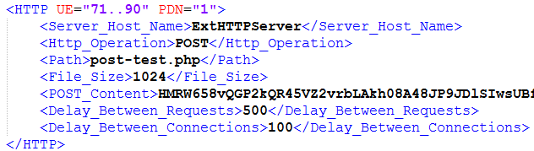
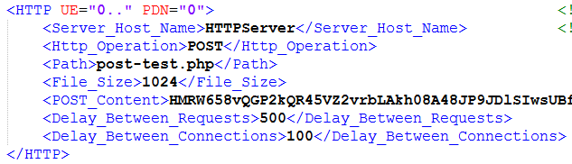
RDA Provisioning
HTTP Client Configuration (POST)
模板默认配置
主要待更新配置
UE/PDN/Server_Host_Name/File_Size/POST_Content

Slide 39
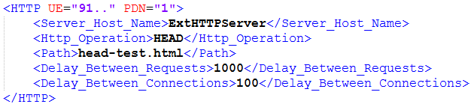
RDA Provisioning
HTTP Client Configuration (HEAD)
模板默认配置
#待进一步拓展。

Slide 40
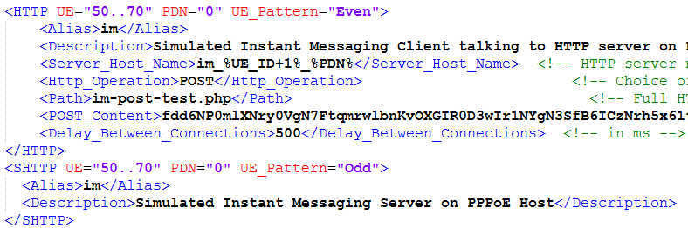
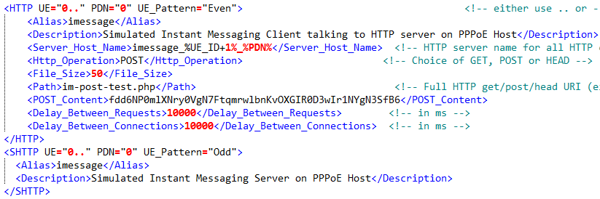
RDA Provisioning
HTTP Client Configuration (IM)
模板默认配置
主要待更新配置
UE/PDN/Alias/File_Size

Slide 41
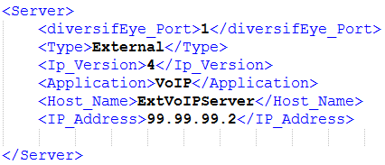
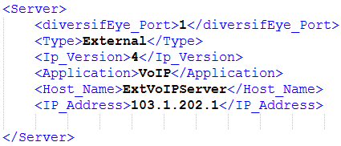
RDA Provisioning
VoLTE Server Configuration
模板默认配置
主要待更新配置
Ip_Version/IP_Address

Slide 42
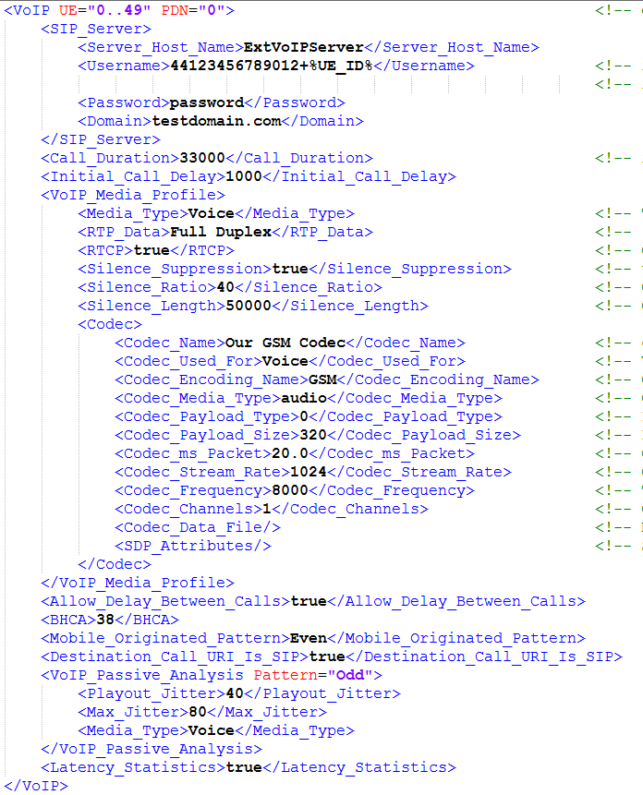
RDA Provisioning
VoLTE Client Configuration (Digest)
模板默认配置

Slide 43
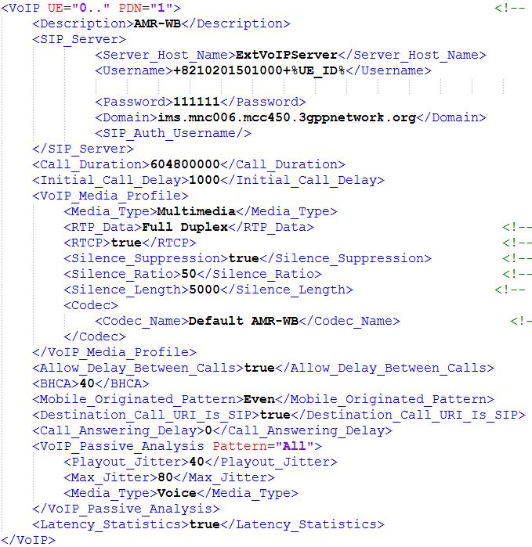
RDA Provisioning
VoLTE Client Configuration (Digest)
主要待更新配置
Username/Password
Domain
SIP_Auth_Username
Call_Duration
Media_Type
Silence_Ratio
Silence_Length
Codec
BHCA
Pattern

Slide 44
RDA Provisioning
VoLTE Client Configuration (AKA)
主要待更新配置
Username/Password
Domain
SIP_Auth_Username
Call_Duration
Media_Type
Silence_Ratio
Silence_Length
Codec
BHCA
Pattern
VoLTE Section
AKA_Key
AKA_Operator_Id
ESP_Encryption_Algorithm
ESP_Auth_Algorithm

Slide 45
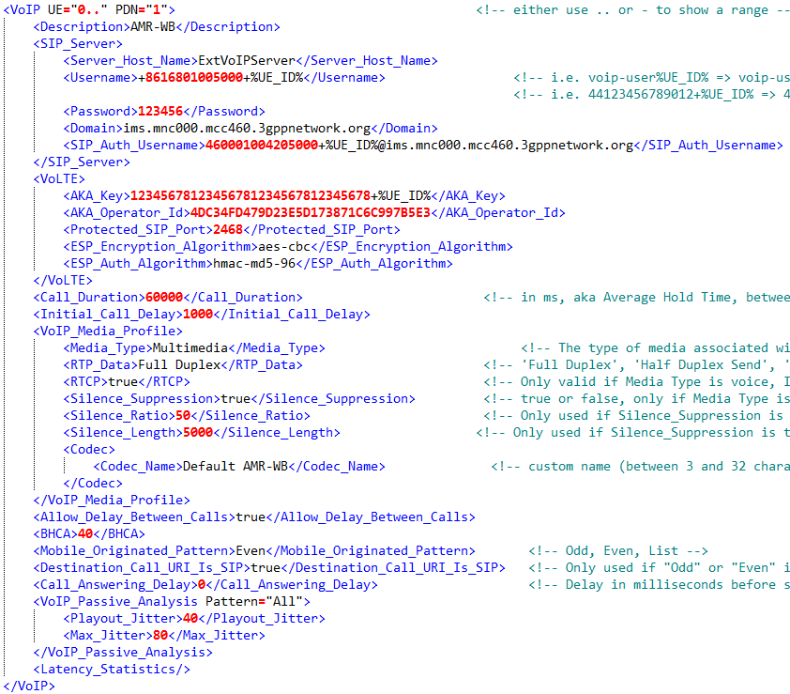
RDA Provisioning
VoLTE Client Configuration (AKA)

Slide 46
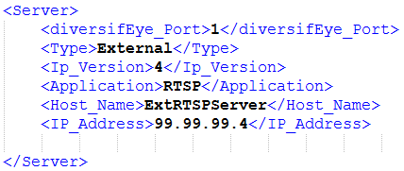
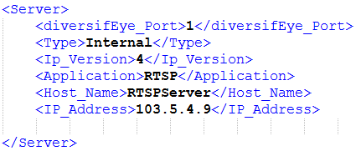
RDA Provisioning
RTSP Server Configuration
模板默认配置
主要待更新配置
Type/Host_Name/IP_Address

Slide 47


RDA Provisioning
RTSP Client Configuration
模板默认配置
主要待更新配置
UE/PDN/Server_Host_Name/RTSP_Media_Profile/Media_Stream_Duration

Slide 48


RDA Provisioning
cPing Client Configuration
cPing不需要配置对应的Server.
模板默认配置
主要待更新配置
UE/PDN/Ping_IP_Address/Start_After/Stop_After/Delay_Between_Pings/Packet_Size

Slide 49


RDA Provisioning
sPing Server & Client Configuration
模板默认配置
#待进一步拓展。

Slide 50


RDA Provisioning
TeraFlow Server Configuration (UL UDP)
模板默认配置
主要待更新配置
Type/Host_Name/IP_Address

Slide 51


RDA Provisioning
TeraFlow Client Configuration (UL UDP)
模板默认配置
主要待更新配置
UE/PDN/Alias/Server_Host_Name/Start_After/Stop_After/Throughput/Throughput_Metric

Slide 52

RDA Provisioning
TeraFlow Server Configuration (DL UDP)
模板默认配置
主要待更新配置
Type/Host_Name/IP_Address

Slide 53

RDA Provisioning
TeraFlow Client Configuration (DL UDP)
模板默认配置
主要待更新配置
UE/PDN/Alias/Server_Host_Name/Server_on_PPPoE/Start_After/Stop_After/Throughput/Throughput_Metric

Slide 54


RDA Provisioning
TWAMP Server & Client Configuration
默认模板不含TWAMP相关配置，如有测试需求，请依据如下信息分别配置TWAMP Server/Client.
主要待更新配置
IP_Address/Delay_Between_Packets/Payload_Size

Slide 55

RDA Provisioning
Profile_0 Configuration
模板默认配置

Slide 56

RDA Provisioning
Profile_0 Configuration
如果不想定义Profile_0，请更新上述配置为</Profile_0>.

Slide 57

RDA Provisioning
Network Configuration
模板默认配置
主要待更新配置
Gateway_IP/Gateway_IPv6

Slide 58

RDA Provisioning
live.bat和TM500.xml配置完成后，请在Provisioning文件夹打开DOS窗口，然后运行live.bat即开始生成脚本。

Slide 59
RDA Provisioning
脚本生成成功后，将在Provisioning文件夹保存一份RDA脚本，同时也将自动导入一份脚本至RDA.
可以在RDA客户端进一步更新Application/Host对应的配置。更多配置信息，请参阅本文档附录的Applications & Hosts Properties.
如果脚本生成失败的话，请查看DOS窗口打印的信息，以及Provisioning文件夹下的shenick.log，以进一步定位问题。
如果需要寻求TM500 FAE协助定位，请提供以下信息
TM500.xml
shenick.log

Slide 60

Host Physical Interface
Standalone D500 – Edge/Core
Standalone D500 VLAN Hub端口示意图

Slide 61

Host Physical Interface
D500 Pair -> Edge
Edge VLAN Hub端口示意图

Slide 62

Host Physical Interface
D500 Pair -> Core
Core VLAN Hub端口示意图

Slide 63

Host Physical Interface
D1000

Slide 64

导入和导出脚本

Slide 65
导入和导出脚本
RDA脚本可以导出保存为.xml格式。
可以通过文本编辑器（例如UltraEdit或Notepad++）编辑RDA脚本，例如批量替换PPPoE IP (<service_name>tm500_lte_10.99.0.2_500_0</service_name>)或者Physical Interface (<physical_interface>11/1/0</physical_interface>)，然后再导入RDA，实现RDA脚本批量快速修改。

Slide 66
运行脚本
TM500调用RDA脚本
手动运行脚本

Slide 67


TM500调用RDA脚本
TM500通过cli命令调用运行RDA脚本.
运行/终止脚本
设置PPPoE为In/Out of Service状态
设置Applications为In/Out of Service状态

Slide 68

手动运行RDA脚本
通过RDA客户端运行脚本：选中脚本，然后点击左上角绿色按钮运行脚本。

Slide 69
手动运行RDA脚本
手动设置对应UE的Application/PPPoE为In/Out of Service状态
设置Application为In Service状态之前，首先需要确保PPPoE已经处于In Service状态且PPPoE建立成功（已获取UE IP地址信息）。

Slide 70

设置Application/Host状态
Set In Service

Slide 71

设置Application/Host状态
Set Out Of Service

Slide 72
统计日志分析和保存
实时查看统计日志
保存统计日志
实时抓取PDU

Slide 73
RDA Statistics
RDA Statistics分为两大类
Normal Statistics：每30秒钟输出一次统计，默认打开；
Fine Statistics：每1秒钟输出一次统计，默认关闭；
支持实时查看统计信息
基于图形曲线
基于列表
测试脚本运行以后，统计相关的日志自动保存在RDA上，可通过如下方式把日志保存到RDA控制电脑上。
测试脚本正在运行，请用Save Current Detailed Results保存日志。
测试脚本已经停止运行且还尚未再次运行脚本，请用Save Historical Detailed Results保存日志。

Slide 74

实时查看RDA Statistics
Fine Statistics默认关闭

Slide 75

实时查看RDA Statistics
Fine Statistics打开

Slide 76

实时查看RDA Statistics
基于图形的统计显示

Slide 77

实时查看RDA Statistics
配置统计选项
不同Application对应的统计选项，请参阅附录。

Slide 78

实时查看RDA Statistics
基于列表的Fine Statistics

Slide 79

实时查看RDA Statistics
基于列表的Normal Statistics

Slide 80

保存统计日志
Save Current Detailed Results

Slide 81

保存统计日志
Save Historical Detailed Results

Slide 82


实时抓取PDU
RDA支持实时抓取任意Node/Application/Host的PDU.
为了在RDA客户端直接打开抓取的PDU日志，请先安装Wireshark并把Wireshark安装路径添加至系统环境变量。
Wireshark下载路径： https://www.wireshark.org/download.html
添加系统环境变量

Slide 83

实时抓取PDU
右键点击对应的Node/Application/Host，在弹出的菜单里选择Capture PDU’s.

Slide 84

实时抓取PDU
可以按照抓取包的数目，抓取的时间和包的长度来定义抓取时长。
可以限定抓特定源或目标IP地址的包，默认设置和当前选择的Application相关，如果去掉IP限定的话，将抓取所有的包，和当前Application无关。

Slide 85

实时抓取PDU
抓包的控制窗口在屏幕下方，可以随时停止抓包，也可以查看、保存或者删除抓取的文件。

Slide 86
支持和帮助
RDA基本信息

Slide 87
RDA基本信息
请尽可能提供以下信息和日志以协助RDA问题定位
Current/Historical Detailed Results
RDA脚本
System logs
Chassis Information
脚本正在运行时读取的Card Resource Usage
cli.log

Slide 88

RDA基本信息
System Logs/Chassis Info/Card Resource Usage

Slide 89
RDA基本信息
cli.log
通过FTP Client登录Edge（默认IP：192.168.10.200）
用户名：cli
密码：diversifEye
下载cli.log

Slide 90
Appendix
Gracefully Reboot and Restart RDA
RDA Management Web Interface
Normal/Fine Statistics
VLAN Configurations
Upgrade System and License Installation
Additional Applications Introduction
Troubleshooting

Slide 91
Gracefully Restart and Shutdown RDA
via RDA Client GUI
via SSH

Slide 92
Restart and Shutdown RDA
重启和关机RDA的两种方式
RDA Client GUI
对于Edge & Core的配置，通过此方式将同时重启或下电两台设备。
SSH
对于Edge & Core的配置，需要分别SSH到Edge（默认IP: 192.168.10.200）和Core（默认IP: 192.168.10.201）进行重启或下电的操作。
重启
用户名：reboot 密码：restartd
关机
用户名：poweroff 密码：shutdown
注意：异常断电可能导致RDA损坏，需要返厂维修，所以请不要强行下电或拔电源。

Slide 93

Restart and Shutdown RDA
via RDA Client GUI

Slide 94


Restart and Shutdown RDA
via SSH

Slide 95
RDA Management Web Interface
Download System Logs
diversifEye System Information
Card Resource Usage
Client Install
Online Help
Global Settings for All Cards
Admin – Network Properties
Admin – Global Settings for Each Cards

Slide 96

Home – Admin
Download System Logs

Slide 97

Home – Admin
Username/Password

Slide 98

Home – Admin
diversifEye Chassis Information

Slide 99

Home – Admin
Chassis Info - diversifEye System Information

Slide 100

Home – Admin
Chassis Info - diversifEye License Information

Slide 101

Home – Admin
Card Resource Usage

Slide 102

Home – Admin
Card Resource Usage

Slide 103

Home
Client Install

Slide 104

Home
Online Help

Slide 105

Home – Admin
Global Settings – All Cards

Slide 106

Home
Admin

Slide 107

Home – Admin
Network Properties

Slide 108

Home – Admin
Global Settings

Slide 109

Home – Admin
Global Settings - Select Cards

Slide 110

Home – Admin
Global Settings – Host IPv6 Settings

Slide 111

Home – Admin
Global Settings – Mandatory Configurations for IPv6

Slide 112
Applications & Hosts Properties
Applications
FTP/VoLTE/TeraFlow/RTSP/PING/HTTP/TWAMP
Hosts
Gateway/Internal Server/External Server/PPPoE

Slide 113
Applications – FTP
Overview

Slide 114

Applications – FTP
Command Lists (get)

Slide 115

Applications – FTP
Command Lists (put)

Slide 116

Applications – FTP
Internal Server Resource List

Slide 117

Applications – FTP
Shared Client Resource List

Slide 118

Applications – FTP
FTP Client Properties

Slide 119



Applications – FTP
TCP Characteristics Properties

Slide 120


Applications – FTP
FTP Client Properties

Slide 121


Applications – FTP
FTP Client Properties & Profile

Slide 122

Applications – FTP
Add Profile

Slide 123

Applications – FTP
Add Profile

Slide 124

Applications – FTP
FTP Server Properties

Slide 125


Applications – FTP
FTP Server Properties

Slide 126

Applications – VoLTE
Overview

Slide 127

Applications – VoLTE
Add Codec AVP

Slide 128

Applications – VoLTE
Add Codec AVP

Slide 129


Applications – VoLTE
VoIP UA Properties

Slide 130

Applications – VoLTE
Authentication Details

Slide 131


Applications – VoLTE
VoIP UA Properties

Slide 132



Applications – VoLTE
VoIP UA Properties

Slide 133

Applications – VoLTE
RTP Stream Profiles

Slide 134



Applications – VoLTE
RTP Stream Profile Properties

Slide 135

Applications – VoLTE
VoIP Call List Properties

Slide 136

Applications – VoLTE
External VoIP Proxy Properties

Slide 137

Applications – DL UDP
TeraFlow Client Properties

Slide 138


Applications – DL UDP
TeraFlow Client Properties

Slide 139

Applications – DL UDP
TeraFlow Server Properties

Slide 140


Applications – DL UDP
TeraFlow Server Properties

Slide 141

Applications – DL UDP
TeraFlow Server Properties

Slide 142

Applications – UL UDP
TeraFlow Client Properties

Slide 143


Applications – UL UDP
TeraFlow Client Properties

Slide 144

Applications – UL UDP
TeraFlow Server Properties

Slide 145

Applications – RTSP
RTSP Client Properties

Slide 146


Applications – RTSP
RTSP Client Properties

Slide 147


Applications – RTSP
RTSP Client Properties

Slide 148

Applications – RTSP
RTSP Stream Profile Properties

Slide 149

Applications – RTSP
RTSP Stream Profile Properties

Slide 150

Applications – RTSP
RTSP Server Properties

Slide 151


Applications – RTSP
RSTP Server Properties

Slide 152

Applications – PING
Ping Application Properties

Slide 153


Applications – PING
Ping Application Properties

Slide 154

Applications – HTTP
HTTP Client Properties

Slide 155


Applications – HTTP
HTTP Client Properties

Slide 156


Applications – HTTP
HTTP Client Properties

Slide 157

Applications – HTTP
HTTP Server Properties

Slide 158


Applications – HTTP
HTTP Server Properties

Slide 159

Applications – HTTP
Request Lists (GET)

Slide 160

Applications – HTTP
Request Lists (POST)

Slide 161




Applications – HTTP
Request Lists (POST)

Slide 162

Applications – HTTP
Internal Server Resource List

Slide 163

Applications – TWAMP
TWAMP Client Properties

Slide 164


Applications – TWAMP
TWAMP Client Properties

Slide 165

Applications – TWAMP
TWAMP Server Properties

Slide 166

Hosts – Gateway

Slide 167

Hosts – Internal Server
Host Properties

Slide 168


Hosts – Internal Server
Host Properties

Slide 169


Hosts – Internal Server
Host Properties

Slide 170


Hosts – Internal Server
Host Properties

Slide 171

Hosts – External Server
Host Properties

Slide 172

Hosts – PPPoE
Host Properties

Slide 173


Hosts – PPPoE
Host Properties

Slide 174
Normal/Fine Statistics

Slide 175


Applications – FTP Client

Slide 176


Applications – FTP Server

Slide 177


Applications – VoLTE

Slide 178


Applications – RTSP Client/Server

Slide 179

Applications – PING

Slide 180



Applications – HTTP Client/Server

Slide 181



Applications – TWAMP Client/Server

Slide 182

Hosts – Internal Server/PPPoE

Slide 183
VLAN Configurations

Slide 184
VLAN Configurations
请参阅TTK780_001_Issue_3.pdf

Slide 185
Upgrade System & License Installation

Slide 186
RDA Upgrade System
RDA软件版本升级，请联系TM500 FAE.

Slide 187
Additional Applications
Voice services
Video services
Media & Voice Passive Analysis
TWAMP – Two Way Active Measurement
Thresholding
TeraFlow
SMS over IMS

Slide 188



Voice services
Will Voice be “just” data?
Explosive demand, increasing price pressure and OTT competition drive VoLTE
Opens new business opportunities
Helps improve customer experience
Cobham VoLTE option allows emulation of VoLTE UEs with different audio codecs to ensure that the coveted QoE improvements are achieved, VoLTE traffic is prioritized appropriately through the entire network and performance can be optimized
4G Americas VoLTE_RCS TECHNOLOGY ECO-SYSTEM AND EVOLUTION

Slide 189


Video services
Video on demand (VoD) and video streaming (VS) are the most popular applications in LTE networks and thus are under most scrutiny for quality of experince.
Cobham Video service option allows emulation of UEs connecting to VoD or VS servers as well as emulation of these servers to see the impact on the network performance or to see the network impact on the Video service performance.
Cobham implementation supports multiple Audio and Video codecs which allows users to test with scenarios that reflect their own network or to evaluate planned deployment performance.
Ericsson-mobility-report-june-2014

Slide 190


Media & Voice Passive Analysis
Service’s overall quality is how the video or the audio quality is perceived by consumers. This is typically examplified with Mean Opinion Score (MOS). Cobham’s Passive Analysis option allows to quantify how network layer imperfections affect this quality of experience (QoE) factor.
Cobham implementation supports both audio and video quality analysis and also uses:
Jitter Buffer models real UE packet queuing and playback effects to
detect lost packet
Predict which packets would be discarded
Markov Model to statistically learn the distribution of lost and discarded packets during a call, and then apply this distribution for MOS calculation

Slide 191


TWAMP – Two Way Active Measurement
Measuring the performance of IP networks is a challenge
Standard tools were designed for simple troubleshooting
The Two-Way Active Measurement Protocol (TWAMP)
defines a flexible method for measuring round trip IP performance among any two devices in a network that support the standard
provides a flexible choice of solutions and full visibility into network performance
Cobham TWAMP option is
Compliant to work with any network element that supports TWAMP
Allows measurements between any two endpoints
IP performance can be measured effectively at all locations in the network
Notes:
Measuring the performance of IP networks through the use of standard protocols has always been a challenge.
The inventors of IP provided some tools, such as ICMP Ping, Traceroute and UDP Echo, as part of the TCP/IP suite of protocols.
Measuring the performance of IP networks through the use of standard protocols has always been a challenge. These tools were not intended to conduct overall performance measurements but were designed for simple troubleshooting of IP networks.
The Two-Way Active Measurement Protocol (TWAMP) defines a flexible method for measuring round-trip IP performance among any two devices in a network that support the standard.
TWAMP provides a flexible choice of solutions and full visibility into network performance
It is compliant to work with the routers and switches in the network.
Any two endpoints can interoperate and therefore obviate the need for managers to deploy systems with closed proprietary protocols for measuring performance.
Standards-based performance measurement protocols to create an ecosystem where IP performance metrics are obtained through cooperation among network elements.
Through the use and deployment of TWAMP the IP performance can be measured effectively at all locations.

Slide 192


Thresholding
Cobham Thresholding Option
automatically determines if the expected performance criteria has not been met during testing
Saves time by identifying what, where and when it has been outside of tolerance
Allows monitoring of multiple applications simultaneously with different criteria
Different UE groups (for example VIP customers and data only subscriptions) can have individual criteria
Setting up different violation and clearance duration

Slide 193


TeraFlow
Cobham TeraFlow Option creates TCP and/or UDP protocol traffic. This allows easily create “background” traffic while validating that other applications maintain acceptable level of performance.
Cobham TeraFlow Option
Generation of traffic at pre-defined level
Mirroring the UE data back for bi-directional measurement
Can be configured and turned On and Off per UE

Slide 194



SMS over IMS
The IP Multimedia System (IMS) is not only used for VoLTE, but also to deliver other services such as traditional messaging services (SMS).
Cobham SMS option allows emulation UEs to connect to IMS SMS servers and ensure that the coveted integration of SMS services function properly and transmission and reception of SMS messages works properly through the entire network.
Nielsen Mobile-Consumer-Report-2013

Slide 195
Troubleshooting

Slide 196
Troubleshooting
脚本无法导入RDA内
检查脚本Physical Interface是否和当前RDA硬件配置匹配。
例如，当前RDA脚本是基于D500 Pairt （Core & Edge）Partition 1生成的，那么对应的Physical Interface分别为10/1/0（Host -> PPPoE）和20/1/1（Host -> Internal Server），如果导入Standalone D500，则需先用文本编辑器把Server对应的Physical Interface更新为10/1/1。
可以用文本编辑器批量替换修改RDA脚本。
例如，把基于Partition 1生成的脚本导入Partition 2使用，则在导入脚本前，需要批量替换PPPoE对应的所有Physical Interface。

Slide 197

Troubleshooting
PPPoE IP地址获取不到
检查网线连接是否正确，尤其是RDA Hub上的端口是否和当前分区对应。
例如，如果当前使用单台D500，并且使用的是分区2，那么RDA的Gb2口应该连接到Hub的1口，TM500的PPPoE口连接到Hub的3口，核心网SGi口连接到Hub的6口。
另外，还需注意TM500侧连接的网口是否是正确的PPPoE口（在TM500上排HLP卡上）。
检查TM500 PPPoE IP地址是否配置正确，可以通过串口线连接到TM500上排的HLP卡查看配置，PPPoE地址为other(o)字段内I2=后面的IP地址。

Slide 198

Troubleshooting
PPPoE IP地址获取不到
检查RDA脚本内PPPoE的IP地址是否与TM500 PPPoE口的IP地址一致。

Slide 199
Troubleshooting
PPPoE IP地址获取不到
检查RDA脚本内PPPoE的Physical Interface是否正确。例如，如果当前使用单台D500，并且使用的是分区3，那么PPPoE的Physical Interface应该是12/1/0。
如果以上配置和连线都没有问题，那么需要检查VLAN配置是否正确。注意单台RDA和一对RDA使用时配置的不同。比如，单台D500时，只需要一个Hub，VLAN 10在2口，VLAN11在3口，VLAN12在4口为Untag状态，VLAN16在5口，VLAN17在6口，VLAN 18在7口为Untag状态；一对D500时，需要两个HUB，VLAN 10~15分别在EDGE HUB的2~7口上Untag，VLAN 16~21分别在CORE HUB的2~7口上Untag。

Slide 200
Troubleshooting
TMA无法调用RDA脚本
检查TMA脚本内，RDA脚本名称和分区等信息是否配置正确。
TM500控制口和RDA管理口Gb1需连在同一个Hub，且它们的IP在同一个网段。

Slide 201

Troubleshooting
如何调试RDA业务不通
请先检查FTP/HTTP/UDP Server能否Ping通Gateway和pppoe_0000_0.
在RDA客户端Hosts页面，右键点击FTP/HTTP/UDP Server，选择Ping From；

Slide 202

Troubleshooting
如何调试RDA业务不通
选择Entity type为Host，然后点击IP address右边的小图标；

Slide 203


Troubleshooting
如何调试RDA业务不通
选择Host为Gateway；

Slide 204

Troubleshooting
如何调试RDA业务不通
确保从FTP/HTTP/UDP Server可以Ping通Gateway；
同理，请确认从FTP/HTTP/UDP Server可以 Ping通pppoe_0000_0；
如果FTP/HTTP/UDP Server无法Ping通Gateway，请确认：
Gateway是否可Ping；
Gateway/FTP/HTTP/UDP Server IP及子网掩码是否配置正确；

Slide 205

Troubleshooting
如何调试RDA业务不通
尝试找一台电脑，把IP配置为Gateway的IP，然后连接到VLAN Hub对应的SGi口，确认能否从FTP/HTTP/UDP Server Ping通这个IP，以确定是Gateway还是Gateway与SGi连接网线引起的异常；
如果FTP/HTTP/UDP Server都能Ping通Gateway和pppoe_0000_0，但是Shenick依然业务不通，请检查FTP/HTTP/UDP Server属性所配置的MTU是否超过了EPC/eNB配置的MTU。

Slide 206
Troubleshooting
无法抓取有效的出问题UE的PDU
比如VoIP测试中，有些问题会随机出现在某些UE上，如果问题出现之后再到对应的Application上抓取PDU，将不能抓到出问题时的log，如果提前抓取，又不确定问题会出现在哪些UE上。对于这种情况，可以随意选择一个UE的Application然后在抓取PDU时去掉对于源和目标IP地址的限制，这样就可以抓取所有UE的log了，问题出现之后，再在WiresharK内过滤出对应UE的IP地址就可以了。

Slide 207
References
Real Data Apps Overview.pptx
RDA_D500-D1000.pptx
TTK780_001_Issue_3.pdf

Slide 208
Change History
Version | Date | Author | Reviewed by | Approved by | Change history
0.1 | 10/05/2016 | Klein Jiang | NA | NA | Initial draft
0.2 | 29/05/2016 | Klein Jiang | NA | NA | Reviewed by Corey/Sining
0.3 | 21/06/2016 | Klein Jiang | NA | NA | Reviewed by Klein
0.4 | 25/07/2016 | Klein Jiang | NA | NA | Update

